Slide 1

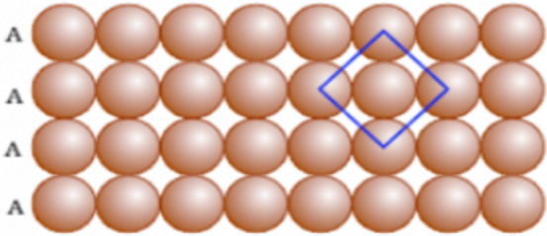
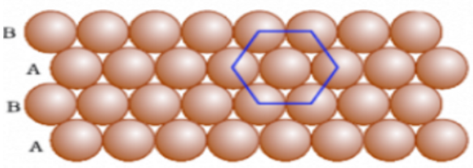
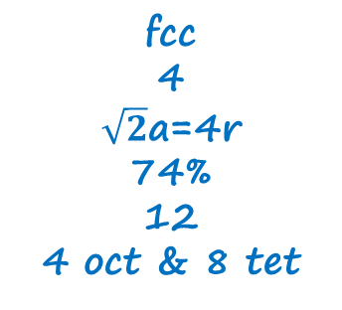
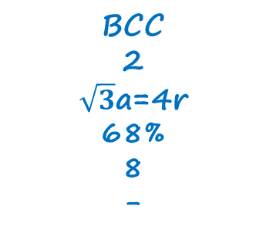
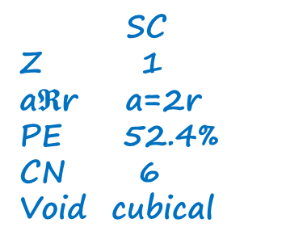
1-D
2-D scp
2-D hcp
P. Eff =78.5%
P. Eff =90.5%
2nd layer on atom
AAAA type
2nd layer on void
ABAB type
2nd layer on TV
ABAB type
hcp
2nd layer on oct
ABCABC type
ccp
SC
Z 1
a$𝕽$r a=2r
PE 52.4%
CN 6
Void cubical
BCC
2
$\sqrt{3}$a=4r
68%
8
-
Hexagonal
6
-
74%
12
6 oct & 12 tet
fcc
4
$\sqrt{2}$a=4r
74%
12
4 oct & 8 tet

